Slide 1
NAME OF THE PROJECT Malignant Comment Classifier
Submitted by:
Arshi Maitra

Slide 2
Acknowledgement:
This project has been completed with the help of training documents and live classes recordings from Data Trained Education. Few helps on coding have also been taken from few data science websites like Toward Data Science, Geek for Geeks, Stack Overflow

Slide 3
INTRODUCTION
The proliferation of social media enables people to express their opinions widely online. However, at the same time, this has resulted in the emergence of conflict and hate, making online environments uninviting for users. Although researchers have found that hate is a problem across multiple platforms, there is a lack of models for online hate detection. Online hate, described as abusive language, aggression, cyberbullying, hatefulness and many others has been identified as a major threat on online social media platforms. Social media platforms are the most prominent grounds for such toxic behavior. There has been a remarkable increase in the cases of cyberbullying and trolls on various social media platforms. Many celebrities and influences are facing backlashes from people and have to come across hateful and offensive comments. This can take a toll on anyone and affect them mentally leading to depression, mental illness, self-hatred and suicidal thoughts. Internet comments are bastions of hatred and vitriol. While online anonymity has provided a new outlet for aggression and hate speech, machine learning can be used to fight it. The problem we sought to solve was the tagging of internet comments that are aggressive towards other users. This means that insults to third parties such as celebrities will be tagged as un offensive, but “u are an idiot” is clearly offensive. Our goal is to build a prototype of online hate and abuse comment classifier which can used to classify hate and offensive comments so that it can be controlled and restricted from spreading hatred and cyberbullying.

Slide 4
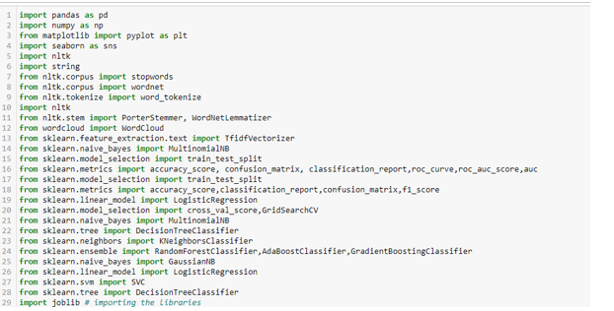
Analytical Problem Framing
Importing Libraries

Slide 5
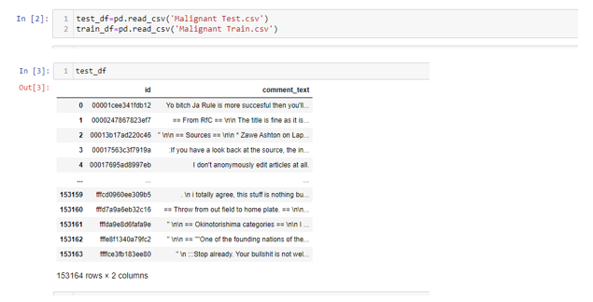
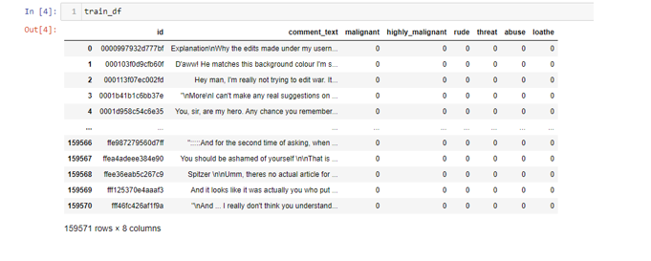
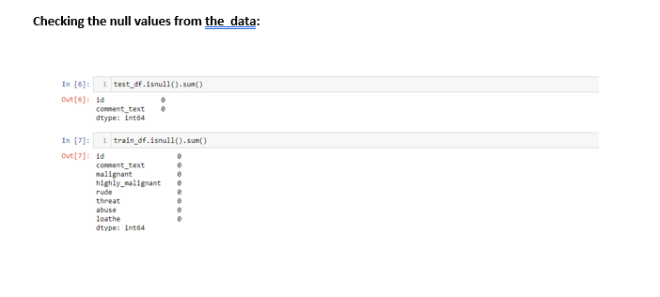
Loading the dataset: Checking the null values from Train and Test data:
(There is no null values in the dataset.)

Slide 6
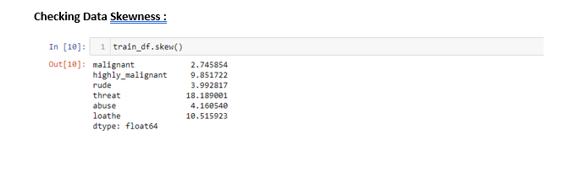
Checking Data Skewness :

Slide 7
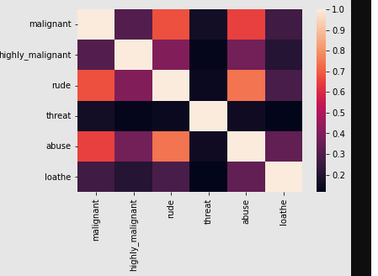
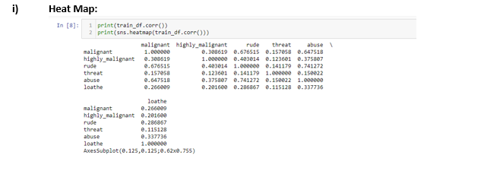
Checking Multicollinearity: 1. Heat Map:

Slide 8
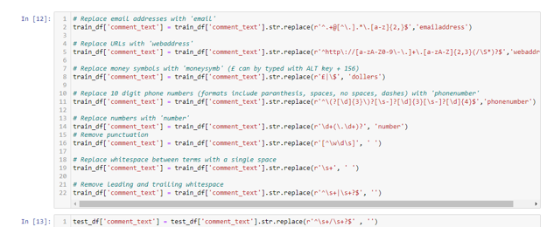
Replacing email address, numbers, white space

Slide 9
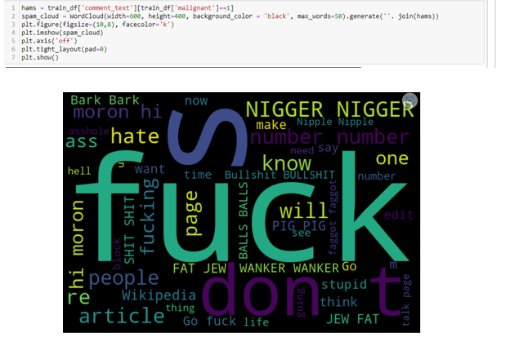
Using Word Cloud

Slide 10
Model/s Development and Evaluation
(Logistic Regression, Decision Tree Classifier, Random Forest Classifier and Gradient Boosting Classifier)

Slide 11
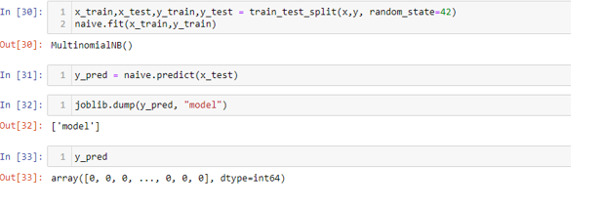
Multinomial NB

Slide 12
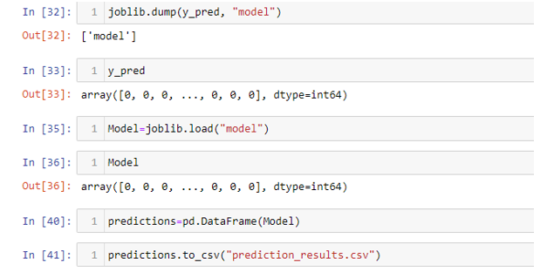
As none of the models are overfitted, and based on the r squared score and cross validation scores, Saving the model

